Slide 1
Scalable Data Analytics
SENG 550
AKA. Big Data - Data Engineering
Armin Zirak

Slide 2
Data Pipelines
11

Slide 3
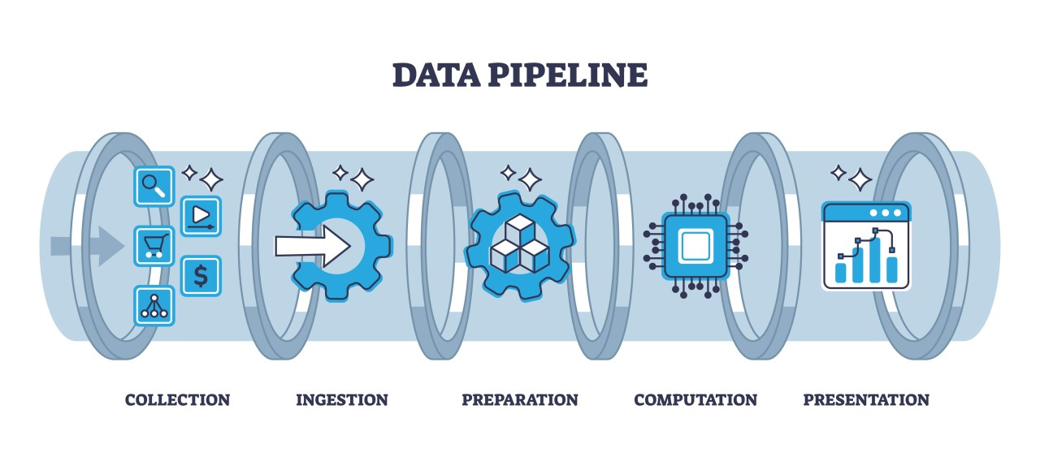
Data Pipeline
A data pipeline is a system that moves data from one place to another place and performs any necessary process along the way.
A data pipeline connects data sources (e.g., databases, APIs, sensors, applications) to destinations (e.g., data warehouses, analytics tools, machine learning models).

Slide 4
Data Pipeline Stages
A typical data pipeline contains three stages.
Data Ingestion: Collecting and bringing data from one or more sources into a storage or processing system.
Data Transformation: Cleaning, reshaping, enriching, and preparing data so it’s usable for analysis or applications.
Data Serving: Making data accessible for consumption by analysts, dashboards, ML models, or applications.

Slide 5
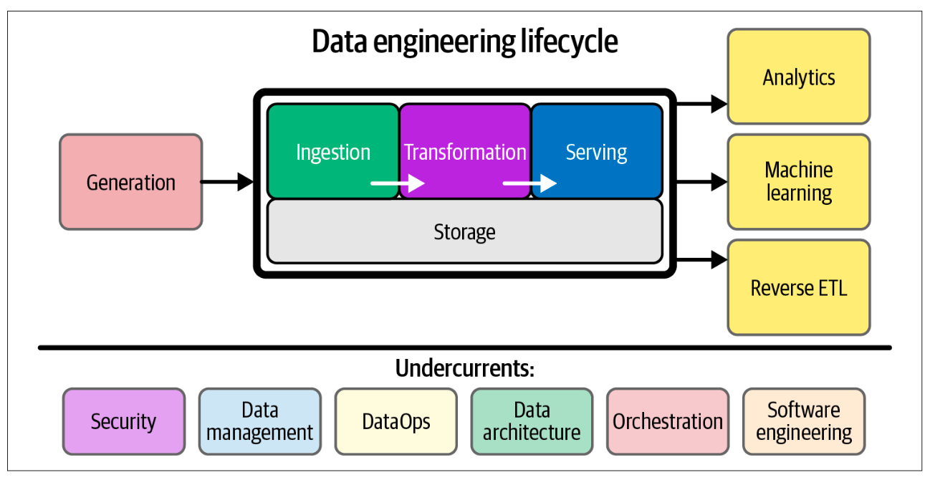
Conceptual Stages

Slide 6
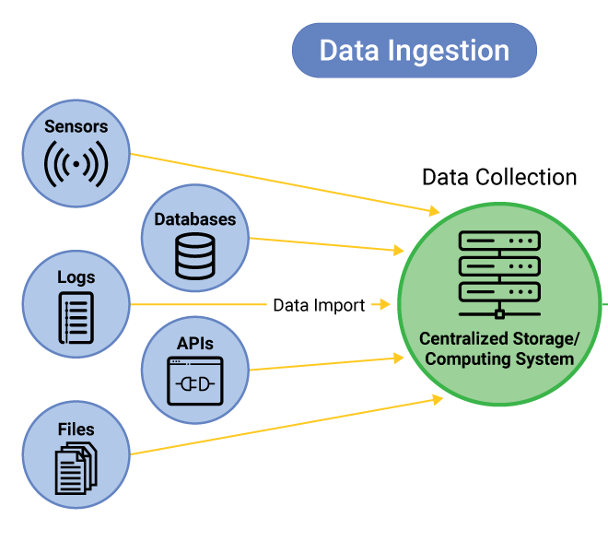
Data Ingestion
Data ingestion is the process of collecting data from one or more sources and bringing it into a system where it can be stored, processed, or analyzed.
It is typically the first stage of a data pipeline.

Slide 7
Data Ingestion Sources
APIs: Data is retrieved from web services or applications
Social media APIs like Twitter, weather APIs
Emails: Third party tools might send the data via email.
SFTP (Secure File Transfer Protocol): Files are transferred from external systems.
Real-Time Streams: Data is constantly flowing from sources such as IoT devices.
Databases: The data can be collected from databases directly.
PostgreSQL, MySQL, MongoDB.

Slide 8
Data Ingestion Modes
Batch Ingestion: Data is collected and moved in discrete chunks at scheduled intervals (hourly, daily, weekly).
Daily CSV exports
Nightly replication of a database to a data warehouse
Scheduled API pulls
Streaming Ingestion: Data is collected and moved continuously as it is generated, in near real-time.
Web clickstream events
IoT sensor data streaming
Real-time stock market feeds

Slide 9
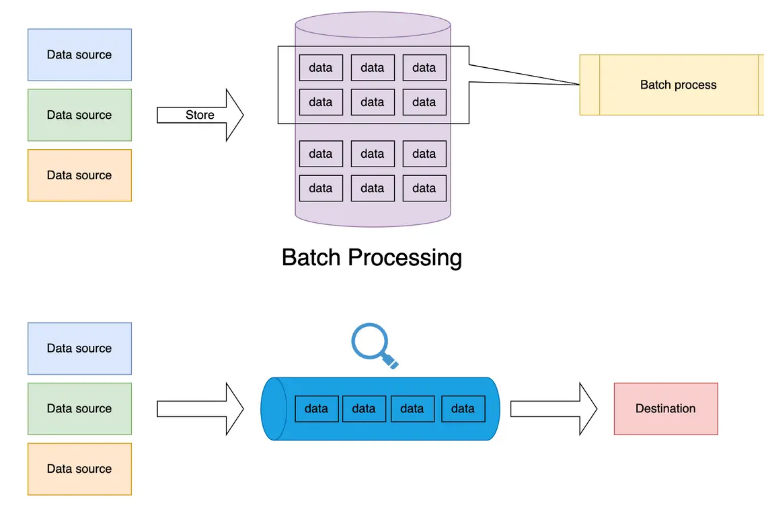
Data Ingestion Modes

Slide 10
Batch Processing
Data is collected and moved in discrete chunks at scheduled intervals (hourly, daily, weekly).
Data is collected over a period (e.g., hourly, daily, weekly) and processed together.
Or, size-based: e.g., 10 MB of data
Has a latency in nature. Results can’t be available before the execution.
Sometimes it’s not an issue at all -> Monthly payroll or billing calculations
Sometimes it becomes a downside -> Receipt of orders.

Slide 11
Batch Processing (Components)
Distribution / Parallelism
Single-node: Processes the batch on one machine; limited throughput.
Distributed: Splits the batch across multiple nodes to handle large datasets efficiently.
Example: Hadoop MapReduce, Spark
Processing Mode
Full batch: Processes all available data at once.
Simpler, less efficient, more accurate
Incremental: Processes only new or changed data since the last batch.
More complex, more efficient, less accurate, sometimes the only possible option

Slide 12
Streaming
Data is collected and moved continuously as it is generated, in near real-time.
Data is processed event-by-event or in small micro-batches.
Low latency. Data doesn’t have to wait for the next scheduled run.

Slide 13
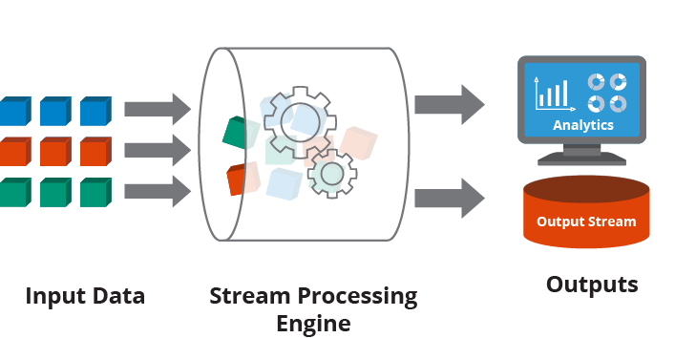
Streaming
Streaming pipelines can be thought of as a continuous data “pipe”, where data flows from producers → streaming system → consumers in real time.

Slide 14
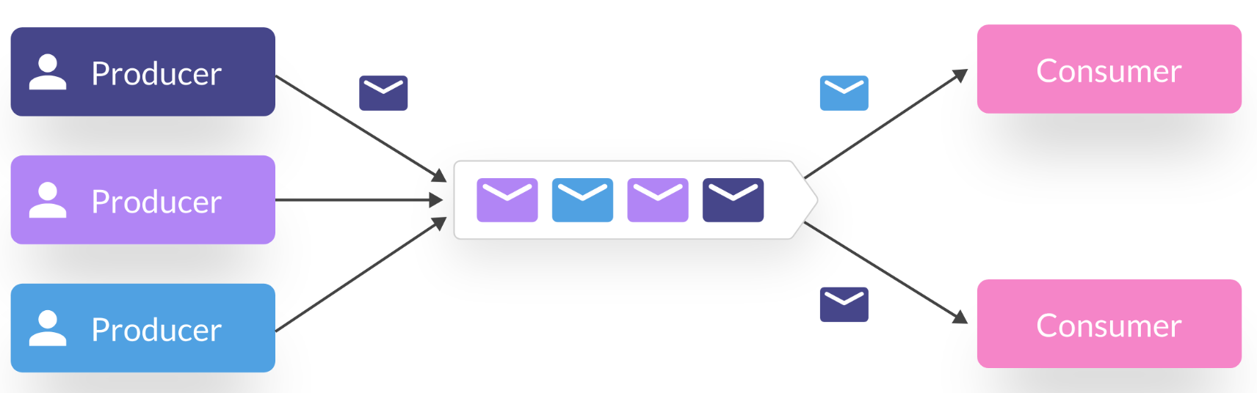
Streaming
Producers: Systems or devices that generate events or data continuously.
web applications, IoT sensors, mobile apps, financial transactions.
Streaming Platform / Middleware: Handles ingestion, buffering, and transport of data streams.
Apache Kafka, Google Pub/Sub, Amazon Kinesis, Spark Streaming.
Consumers: Systems that process, transform, or store the data in near real-time.

Slide 15
Streaming (Characteristics)
Distribution
Non-distributed: Runs on a single node; limited scalability.
Distributed: Splits streams into partitions across multiple nodes for parallel processing.
Example: Kafka, Pulsar, Kinesis are distributed; a simple in-memory queue is non-distributed.
Ordering
Ordered: Guarantees event order within a partition.
Unordered: Makes no ordering guarantees; events may arrive out of sequence.
Example: Kafka preserves partition order; some message queues don’t guarantee order.
Data Point 1 | Data Point 2 | Data Point 3 | Data Point 4 | Data Point 5
Data Point 3 | Data Point 1 | Data Point 4 | Data Point 2 | Data Point 5

Slide 16
Streaming (Characteristics)
Delivery Semantics
At-least-once: Messages may be delivered more than once.
Exactly-once: Each message is delivered only once (deduplicated).
At-most-once: Messages may be lost, but never duplicated.
Example: Kafka can be configured for exactly-once; simpler queues may be at-least-once.
Overflow / Backpressure Handling
Buffered: Temporarily stores messages until consumers can catch up.
Throttled: Limits producer speed to avoid overload.
Dropped: Old messages are discarded when capacity is exceeded.
Example: Kafka buffers to disk; some cloud queues may drop messages if retention is exceeded.

Slide 17
Streaming vs Batch Processing
 | Batch | Streaming
Latency | High | Low
Complexity | Lower. simpler scheduling and deterministic execution | Higher. Requires handling state, ordering, delivery guarantees, and backpressure
Monitoring Debugging | Easier, jobs are deterministic | Harder, continuous, requires real-time metrics, alerting, and troubleshooting partial failures
Efficiency | Usually more efficient to process a bulk (e.g., batch insert to a columnar storage) | Correspondingly, can be less efficient or even impossible.

Slide 18
Hybrid Data Pipelines: Combining Batch and Streaming
Key Idea: A single data pipeline may include multiple components, each of which can operate in batch or streaming mode independently. For example, IoT devices may send data continuously in a streaming fashion. That data can be stored in CSV files, which are then processed in batches and loaded into a database like Redshift. This allows the pipeline to handle real-time data ingestion while still using batch processing for downstream systems that work best with bulk operations.

Slide 19
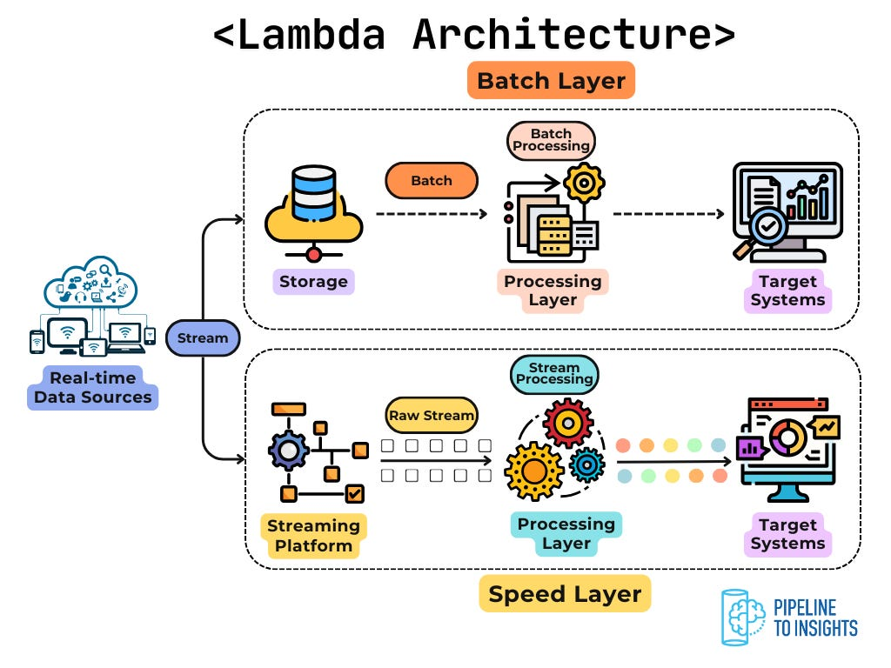
Lambda Architecture
A design pattern that combines batch and streaming processing to provide both accurate and low-latency results.
Batch Layer: Stores all historical data and computes accurate results.
Speed Layer: Processes recent data in real time for low-latency updates.ws.

Slide 20
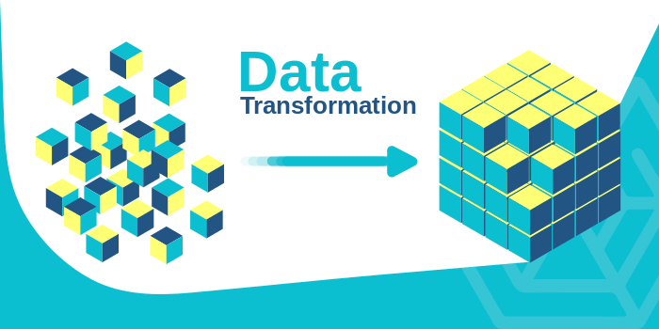
Data Transformation
Transformation is the process of converting raw data into a usable, clean, structured, and analytics-ready form.

Slide 21
Data Transformation Components
Normalization & Denormalization: Adjusting data structure to reduce redundancy (normalization) or combining tables to improve (denormalization)
E.g., denormalizing data in the process of moving from a database to a data warehouse
SELECT
o.order_id,
c.name AS customer_name,
o.total_cost
FROM Orders o
JOIN Customers c
ON o.customer_id =
c.customer_id;

Slide 22
Data Transformation Components (Cleaning)
Data Cleaning: Fixing data quality issues by removing errors, inconsistencies, and invalid values.
Example: Removing duplicate customer records or filling missing weights with 0.
SELECT
id,
COALESCE(weight_kg, 0) AS weight_kg,
ABS(price) AS price
FROM RawItems;

Slide 23
Data Cleaning Examples
Removing trailing white spaces -> “Armin “ -> Armin
Usually, improves performance of ML models.
Improves accuracy of queries. -> select count(‘*’) from orders where city = ‘Calgary’;
Lowercasing
select count(‘ * ’) from emails where email like ‘ % @gmail.com’
Replace empty strings with nulls
select count(‘*’) from orders where city is null.
Filling in missing values
E.g. replace null fees with 0’s.
Fixing Data Types
“2024-01-03” -> Date(2024, 01, 03) : select count(‘*’) from orders where month(purchase_date) = 1;
Remove duplicates
select sum(payment_amount) from orders;
Highlighted queries will have inaccurate results if data in not clean.

Slide 24
Data Cleaning
If the data is not cleaned upstream,
downstream users (e.g., data scientists) will need to spend most of their time cleaning it
they might be unaware and use the low quality data that eventually hurts the business
impacts could be worse dealing with external users.
select sum(payment_amount) from orders; -> duplicate data can cause us to pay more/less to external users;
It is much more efficient for a data pipeline to clean the data and persists it onto the disk (e.g, save into a table) rather than, downstream users do this cleaning every time they query data.
select trim(name) from customers; -> This query trims data every single time it runs.

Slide 25
Data Transformation Components (Enrichment)
Data Enrichment: Enhancing data by adding new calculated fields or joining external information.
Example: Creating cost_per_kg = total_cost / total_weight or bringing in attributes from other datasets
SELECT
i.item,
i.total_cost,
i.total_weight,
i.total_cost / i.total_weight AS cost_per_kg, -- derived field
p.category, -- added attribute
p.brand -- added attribute
FROM Items i
LEFT JOIN ProductInfo p
ON i.item = p.item_id;

Slide 26
Data Transformation Components (Filtering & Aggregation)
Filtering & Aggregation: Selecting relevant data and summarizing it for analysis.
Example: Filtering out cancelled orders and aggregating total sales per day.
WITH filtered AS (
SELECT * FROM Orders
WHERE status <> 'cancelled' -- Remove cancelled orders
)
SELECT
status,
SUM(amount) AS total_amount -- Summarize total sales
FROM filtered
GROUP BY status;

Slide 27
Aggregation Example
order_id | customer_id | city | amount
1 | 1 | Calgary | 150
2 | 2 | Toronto | 300
3 | 1 | Calgary | 450
id | city | amount_sum
1 | Calgary | 600
2 | Toronto | 300

Slide 28
Data Transformation Components (Pivoting and Unpivoting)
Product | Month | Sales
Laptop | October | 10
Laptop | November | 15
Cell Phone | October | 20
Cell Phone | November | 5
Product | Sales October | Sales November
Laptop | 10 | 15
Cell Phone | 20 | 5
Each row represents one item, with other values distributed into columns

Slide 29

Data Transformation <-> Data Ingestion
The choice of data transformation and ingestion often depends on one another.
For streaming data ingestion, real-time transformations are used to process data on the fly.
A function takes data as input and transform and ingest it into target.
Aggregation is more complex with streaming data.
For batch data, SQL code or batch processing tools like Spark are more suitable for aggregation.
DBT (Data Build Tool) has become increasingly popular because it allows for easier implementation of batch transformations within databases or data warehouses.

Slide 30
Data Serving
Data serving is the stage in a data pipeline where transformed data is made available for consumption by end-users, applications, or downstream analytics systems.
Data Warehouses: Store data in Snowflake so analysts can use it.
Data Lakes: Store data in csv in Amazon S3 so ML developers can load it.
Databases
APIs: Give API to other companies who want your data.
SFTP / File Share: Deliver processed data in files (CSV, Parquet, JSON, etc.) to internal or external systems.
Serving can be internal or external
Internal: ML developers, Data Analysts
External: Third Party Clients, Legal Entities
Sometimes data serving on your end, is the data ingestion on the users ends.

Slide 31
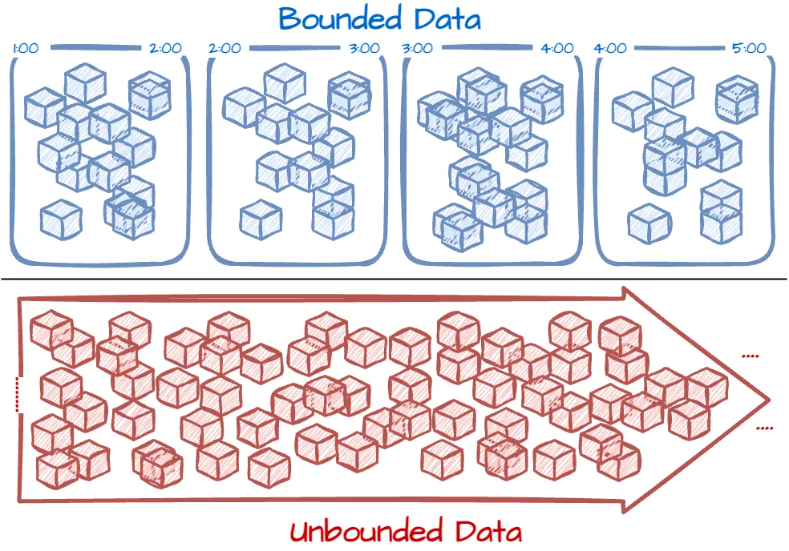
Data Pipeline Characteristics
Each pipeline has a few characteristics…
Bounded vs Unbounded
Batch pipelines are bounded.
Delivery Time
Fast
Slow
E.g., once a day or once a month
Synchronous vs Asynchronous:
Synchronous: Data is ingested in order it is received
Asynchronous: Data may be ingested in a different order than it was produced.

Slide 32
Data Pipeline Characteristics
Throughput and Scalability: How easily does the pipeline scale up?
Huge data might arrive out of a sudden
A new data source is connected
A source that was previously offline (such as API) has come back online again
A huge bonus is for a system that automatically scales up and down
Vertical Scaling vs Horizontal Scaling vs Elastic Cloud Scaling
Reliability
Uptime: The percentage of time the pipeline is ingesting data.
Data: What percentage of data could be lost or corrupted?
Streaming pipelines start to discard data if their capacity is full.

Slide 33
Data Pipeline Characteristics
Serialization: Is the data serialized during ingestion?
Serialization decreases the size. Reduces network bandwidth requirements. But, increases complexities and hurts the performance
Encryption: Payment Methods.
Adaptability to Source Changes: What if the source, adds or removes a column or a table.
select a,b,c from source; [source drops column a].

Slide 34
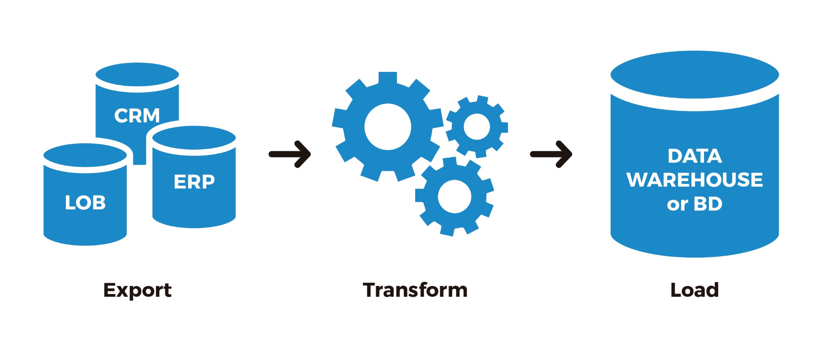
ETL (Extract, Transform, Load)
ETL is a specific type of data pipeline that stands for Extract, Transform, Load.
Extracted from a source system (e.g., database or file)
Transformed into a usable structure
Loaded into a target system (e.g., warehouse)
It’s a frequently used term in industry and typically refers to one step of the whole data pipeline.

Slide 35
ETL (Extract, Transform, Load)
ETL is a specific implementation of the broader ingest-transform-serve pattern, usually batch-oriented.
ETL is typically used when the source and target systems use different technologies and when data must be transformed (e.g., cleaned, reshaped, or enriched) before loading.
In practice, the term ETL is not used consistently across the industry. Many people use it to describe any process that moves and prepares data, even when it doesn’t follow the exact Extract → Transform → Load pattern.

Slide 36
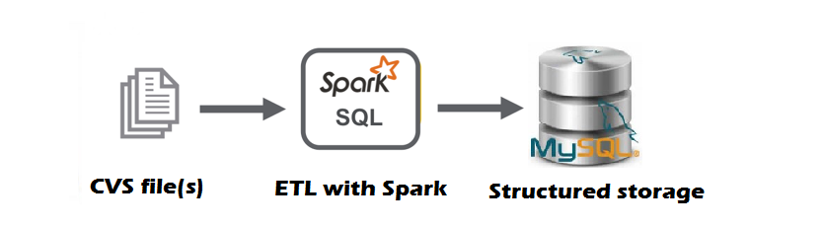
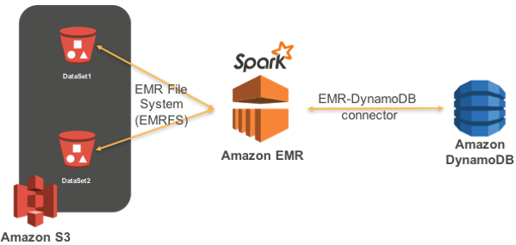
Spark as ETL
Spark is a typical ETL tool.

Slide 37
ETL Limitations
ETL has a few limitations…
Transformations are performed before data is loaded into the data warehouse. Therefore, if the transformation logic changes, the data must be historically transformed and loaded again.
Imagine a Spark ETL pipeline that runs every day, transforming and ingesting the orders from the previous day. What if it turns out that a data cleaning step, which removes certain orders, is inaccurate?
Backfilling with the new logic can be time-consuming, expensive, and sometimes impossible if the source data has been removed.
Backfilling: The process of reloading historical data when the transformation logic has changed.
Developers often feel uncomfortable modifying the transformation code. They need to ensure the logic is correct and pay extra attention to all the details and thoroughly test them before running the pipeline.
ETL tools such as Spark have performance limitations.
Although Spark was a significant improvement over older MapReduce technologies, dataset sizes in the big data world have continued to grow to a point where Spark can become quite expensive to manage.
Result: ELT !

Slide 38
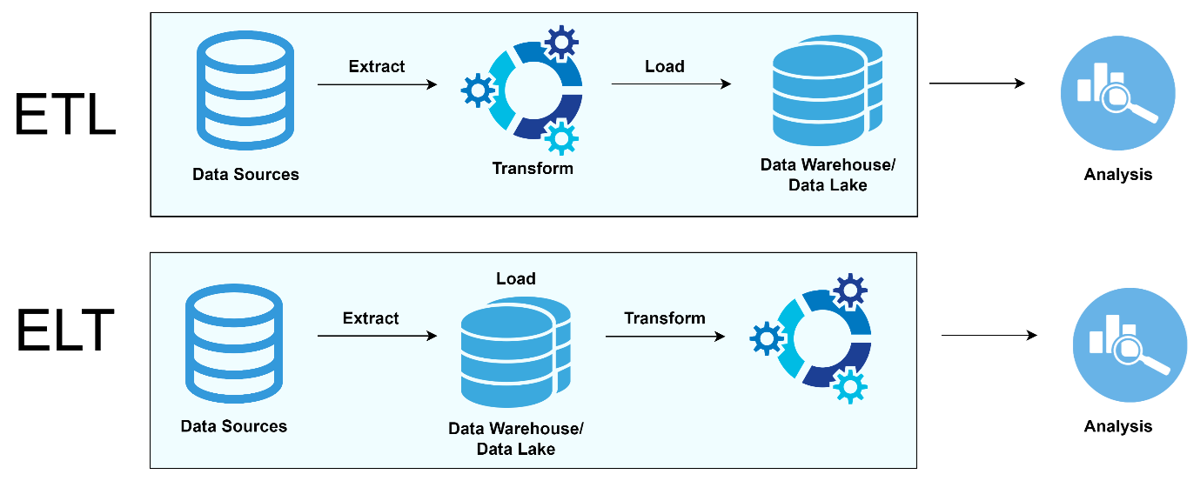
ELT
ELT stands for Extract, Load, Transform.
The ELT pipeline pushes data into the data warehouse in its raw format without applying any transformations.
Transformations can be done inside the data warehouse after the data is loaded.
Transformation can be as simple as running a SQL query within the warehouse.
-- sample inside data warehouse transformation
INSERT INTO orders_summary
(customer_id, total_amount, total_orders)
SELECT
customer_id,
SUM(amount) AS total_amount,
COUNT(order_id) AS total_orders FROM staging_orders
WHERE status = 'Completed'
GROUP BY customer_id;

Slide 39
ELT: In-warehouse Transformation
If the transformation logic is faulty or needs to change, it can be easily modified and rerun within the data warehouse without need for backfilling.
Since the transformation can be just a simple pure SQL query, the data warehouse engine (like Snowflake) can handle processing efficiently.
-- sample inside data warehouse transformation
INSERT INTO orders_summary
(customer_id, total_amount, total_orders)
SELECT
customer_id,
SUM(amount) AS total_amount,
COUNT(order_id) AS total_orders FROM staging_orders
WHERE status = 'Completed'
GROUP BY customer_id;

Slide 40
ELT
Another way is to store data in a data lake (or cloud storage) first, then transform it for a warehouse.
Database (PostgreSQL)
Cloud Storage (Amazon S3)
Data Warehouse
(Amazon Redshift)
Extract - Load
Transformation

Slide 41
ELT: EL Part (Extract - Load)
The EL (Extract, Load) part is quite simple. Data exists in a source, like PostgreSQL, and needs to move to another location, such as Snowflake. No transformation or special logic is required.
Many tools can handle this data ingestion without needing much development effort. For example, if your source has 200 tables, you don’t need to write a pipeline for each one. There are EL tools that just need to be set up to connect to both the source and target, and they can replicate all the data automatically.
For instance, tools like Fivetran or Stitch can connect to a PostgreSQL database and load the data directly into Snowflake without manual intervention.
As a result, the job of an ELT developer can now focus mainly on developing transformations within the data warehouse. This makes the process simpler and allows developers to focus on higher-level concepts, such as optimal data modeling.
In this setting, data engineers only need to know SQL similar to 30 years ago.
Knowing how things work behind the scene and higher level data concepts such as data modeling is still a huge skillset.

